Slide 1

String Data Types (13.3) and Data Type Default Values (13.6)
Project Phase 3 – Team 1
Solomon Henry (Solomon.Henry1@marist.edu) , Erick Perez (erick.perez1@marist.edu), Cayleigh Goberman (cayleigh.goberman1@marist.edu), Cheryl Kumah Kumah(cheryl.kumah1@marist.edu), Jakeline Linares (jakeine.linares1@marist.edu)
Notes:
We need 10-15 slides

Slide 2
What Are String Data Types?
Data Type: Specifies the type of data that a column can hold
String Data Types: Specify that the column can hold a string of data made up of characters
Notes:
https://www.sqltutorial.org/sql-data-types/
https://dev.mysql.com/doc/refman/8.0/en/string-type-syntax.html

Slide 3
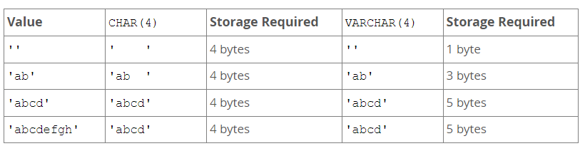
The String Data Types
CHAR: Creates a fixed length that one can declare after creating the table
This length value can be between 0 and 255
If one skips declaring the length variable, it is automatically assigned to 1
If the user enters a string that is less than the declared value, the database will pad the remaining space to fill it to the correct value
Ex: char(24) can hold up to 24 characters. If the user enters only 20 characters, the remaining 4 spaces will be padded.
VARCHAR: Allows a varying length for the inputted string
Length can be from 0 to 65,535
VARCHAR inputs are not padded: varchar(24) would only specify that the column can hold a maximum of 24 characters. 20 characters would be stored as 20 characters, not 24 (20 + 4 padding)
This can reduce the amount of storage required to save data
Notes:
Note: Certain code can specify the amount of padding to be used
https://dev.mysql.com/doc/refman/8.0/en/char.html
https://www.sqltutorial.org/sql-data-types/

Slide 4
The String Data Types
BINARY: Stores a set string of bytes
Similar to CHAR, except stores binary strings instead of nonbinary strings
VARBINARY: Stores a varying string of bytes
Similar to VARCHAR, except stores binary strings instead of nonbinary strings
Unlike CHAR and VARCHAR, the length is measured in bytes, not characters
Notes:
https://dev.mysql.com/doc/refman/8.0/en/binary-varbinary.html

Slide 5
The String Data Types
BLOB: A binary large object that can hold a variable amount of data.
Four blob types: TINYBLOB, BLOB, MEDIUMBLOB and LONGBLOB
They differ only in the maximum length of values they can hold
Blob values are treated as binary strings(byte strings), they have binary character set
TEXT: Stores any kind of text data. Can contain both single-byte and multibyte characters.
Four test types: TINYTEXT, TEXT, MEDIUMTEXT and LONGTEXT
Text values are treated as nonbinary strings(character strings), they have a character set other than binary
Notes:
[8] MySQL
13.3.4 The BLOB and TEXT Types
https://dev.mysql.com/doc/refman/8.0/en/blob.html

Slide 6
The String Data Types
ENUM: A string object with a value chosen from a list of permitted values that are enumerated explicitly in the column specification table at creation time
The strings you specify as input values are automatically encoded as numbers.
The numbers are translated back to the corresponding strings in query results
Enum can have a maximum of 65,535 distinct elements
SET: A string object that can have zero or more values each of which must be chosen from a list of permitted values specified when the table is created
Set column values that consist of multiple set members must be separated by columns
A set column can have a maximum of 64 distinct members
For example, a column specified as SET('one', 'two') NOT NULL can have any of the values '''one' 'two' 'one,two'"
Notes:
MySQL
[9] 13.3.5 The ENUM Type
https://dev.mysql.com/doc/refman/8.0/en/enum.html
[10] 13.3.6 The SET Type
https://dev.mysql.com/doc/refman/8.0/en/set.html

Slide 7
Importance of String Data Types
String data types is the most common type to store text
Strings are important when communicating information from the program to the user of the program
A string can include digits and symbols as well
The data type defines which operations can be performed to create transform and use the variable
Notes:
[11] What Are Data Types and Why Are They Important?
https://amplitude.com/blog/data-types

Slide 8
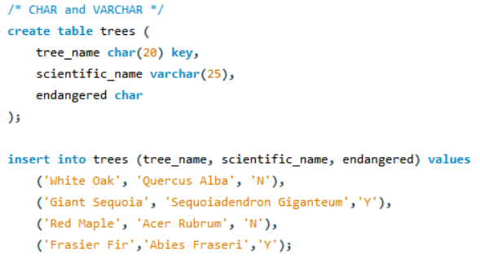
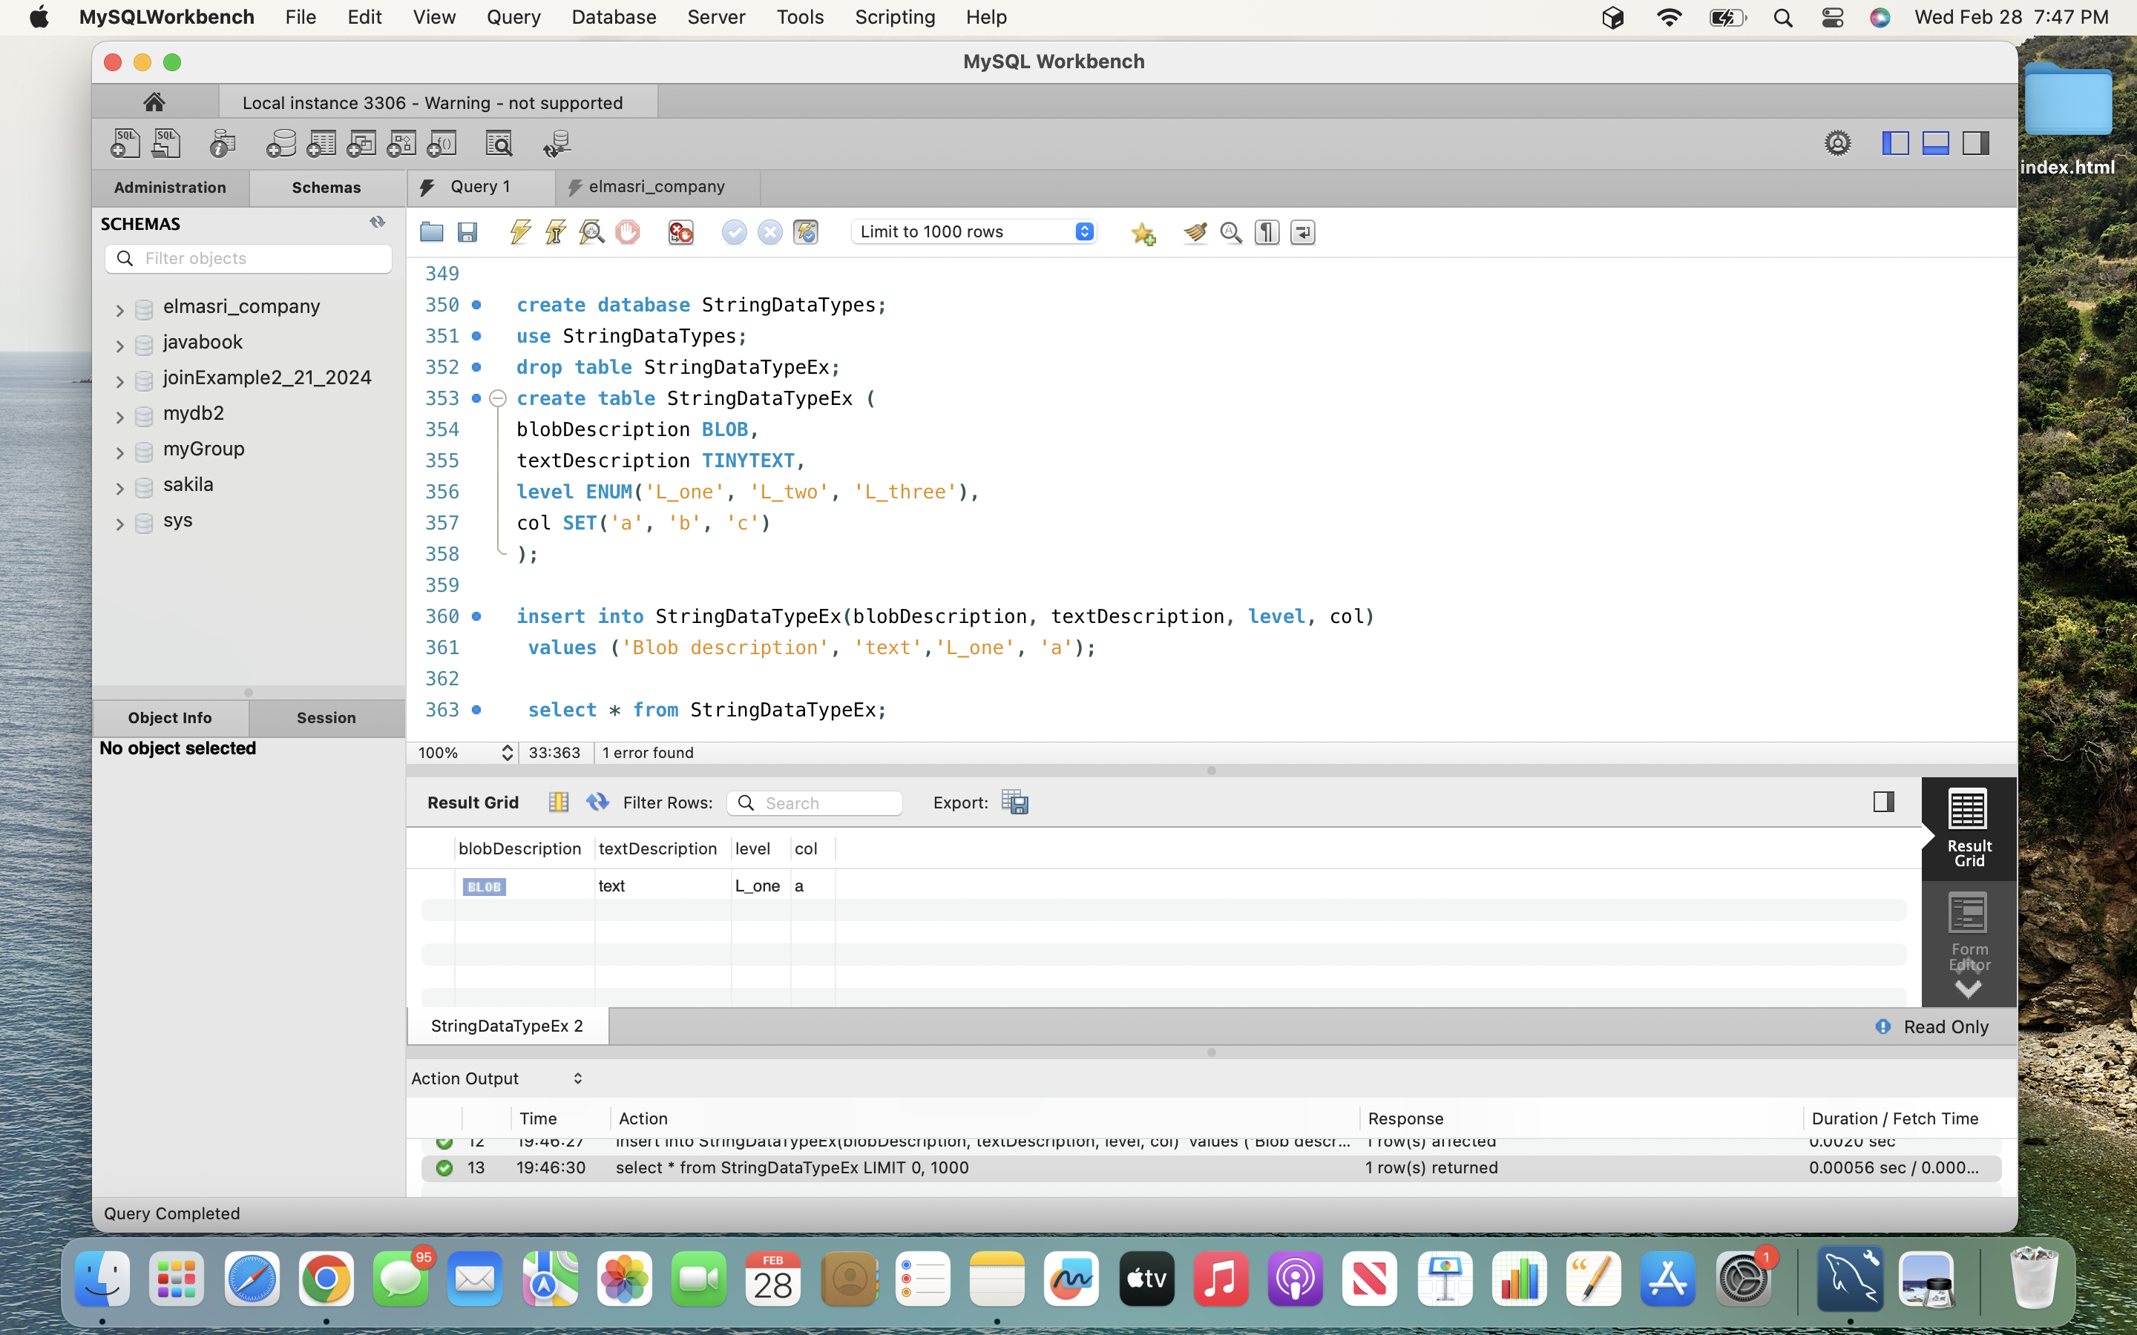
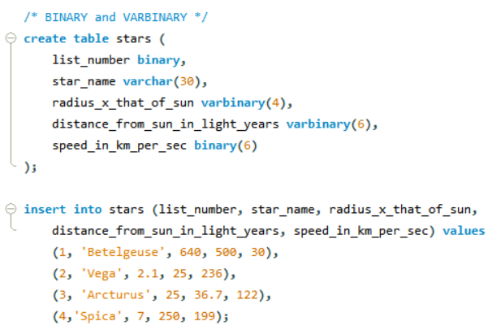
String Data Type Examples
Notes:
We need at least 10 slides of content, so I was thinking we could take screenshots of some of our code and use the Example Slides to transition to our code.

Slide 9
What Are Default Values?
Predefined values that are assigned if no explicit value is provided when a table is created
Setting default values when creating a table
Default values serve as a backup for non-explicit values due to missing data

Slide 10
Explicit Default Value Handling
A Data type specification where the default values are explicitly defined for a data type using the Default clause and can be in the form of a literal or expression (Expressions need to be within parenthesis)
Default values must be a constant, so literals as well as built-in functions are allowed, but subqueries, variables, along with columns with an auto_increment attribute

Slide 11
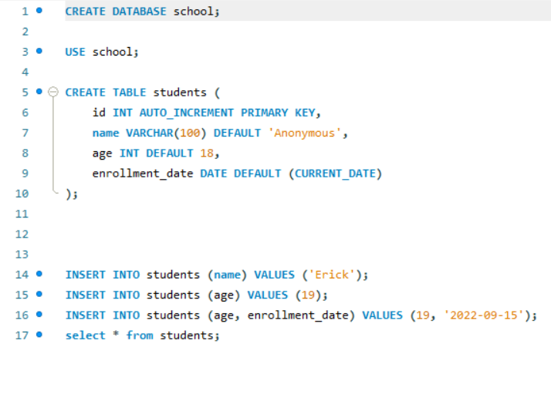

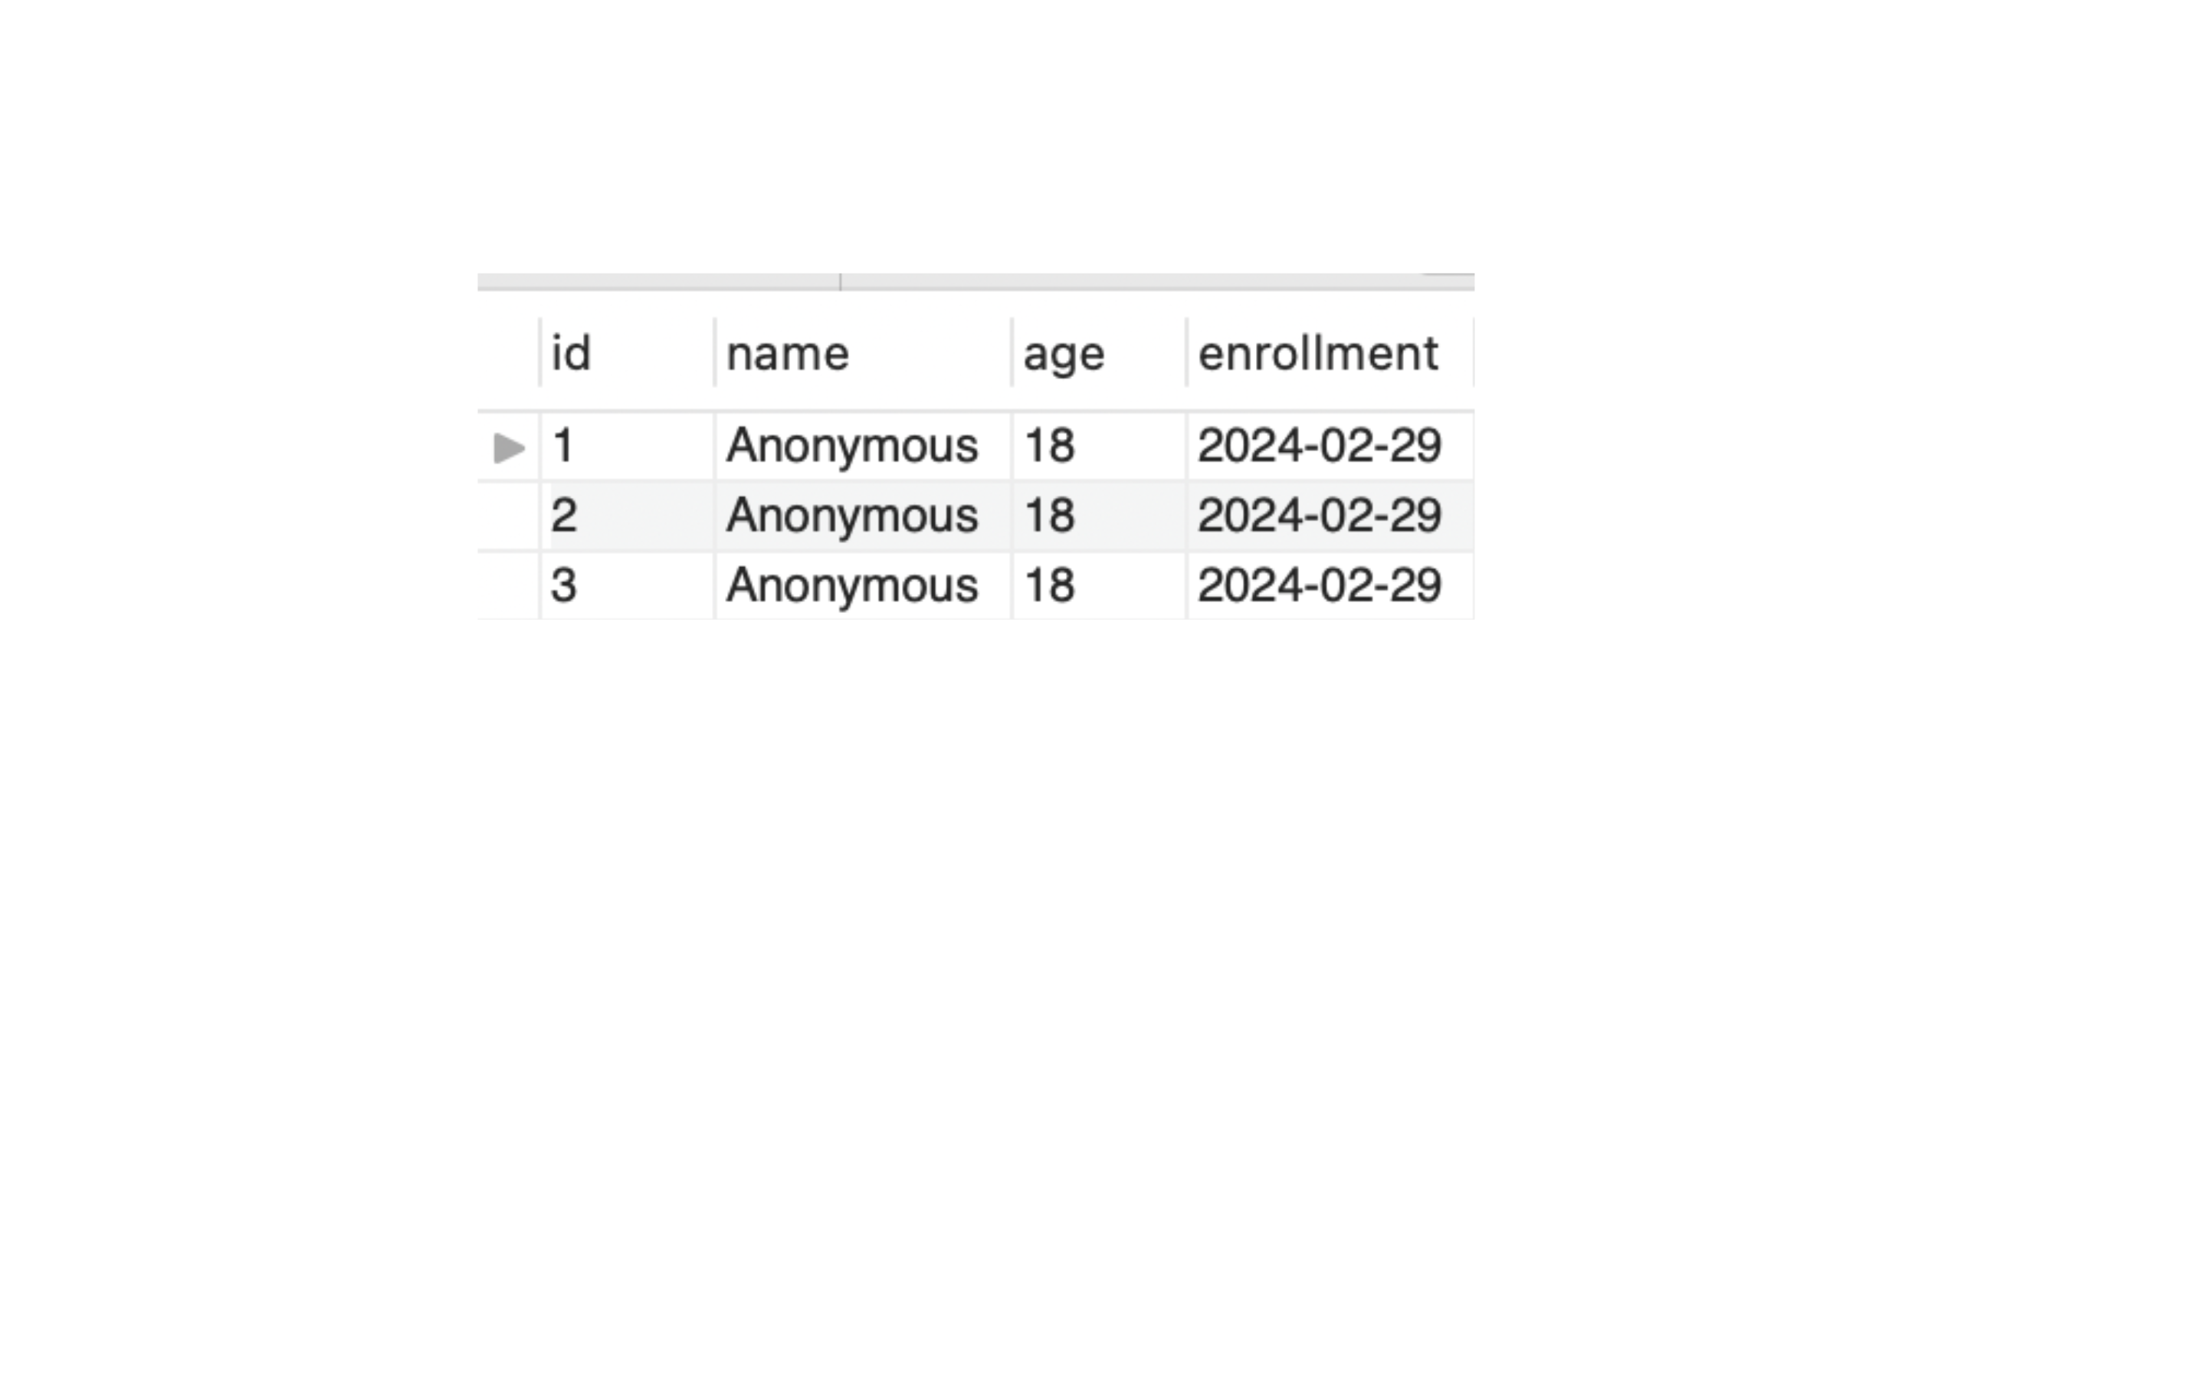
Explicit Default Value Handling

Slide 12
Implicit Default Values Handling
A Data type specification with no explicit Default value is determined by MySQL
If the column allows NULL values, MySQL specifies the column with an explicit Default NULL clause
If the column does not allow NULL values however, then that column's data type implicit default value will be used instead, if SQL strict mode isn't active

Slide 13
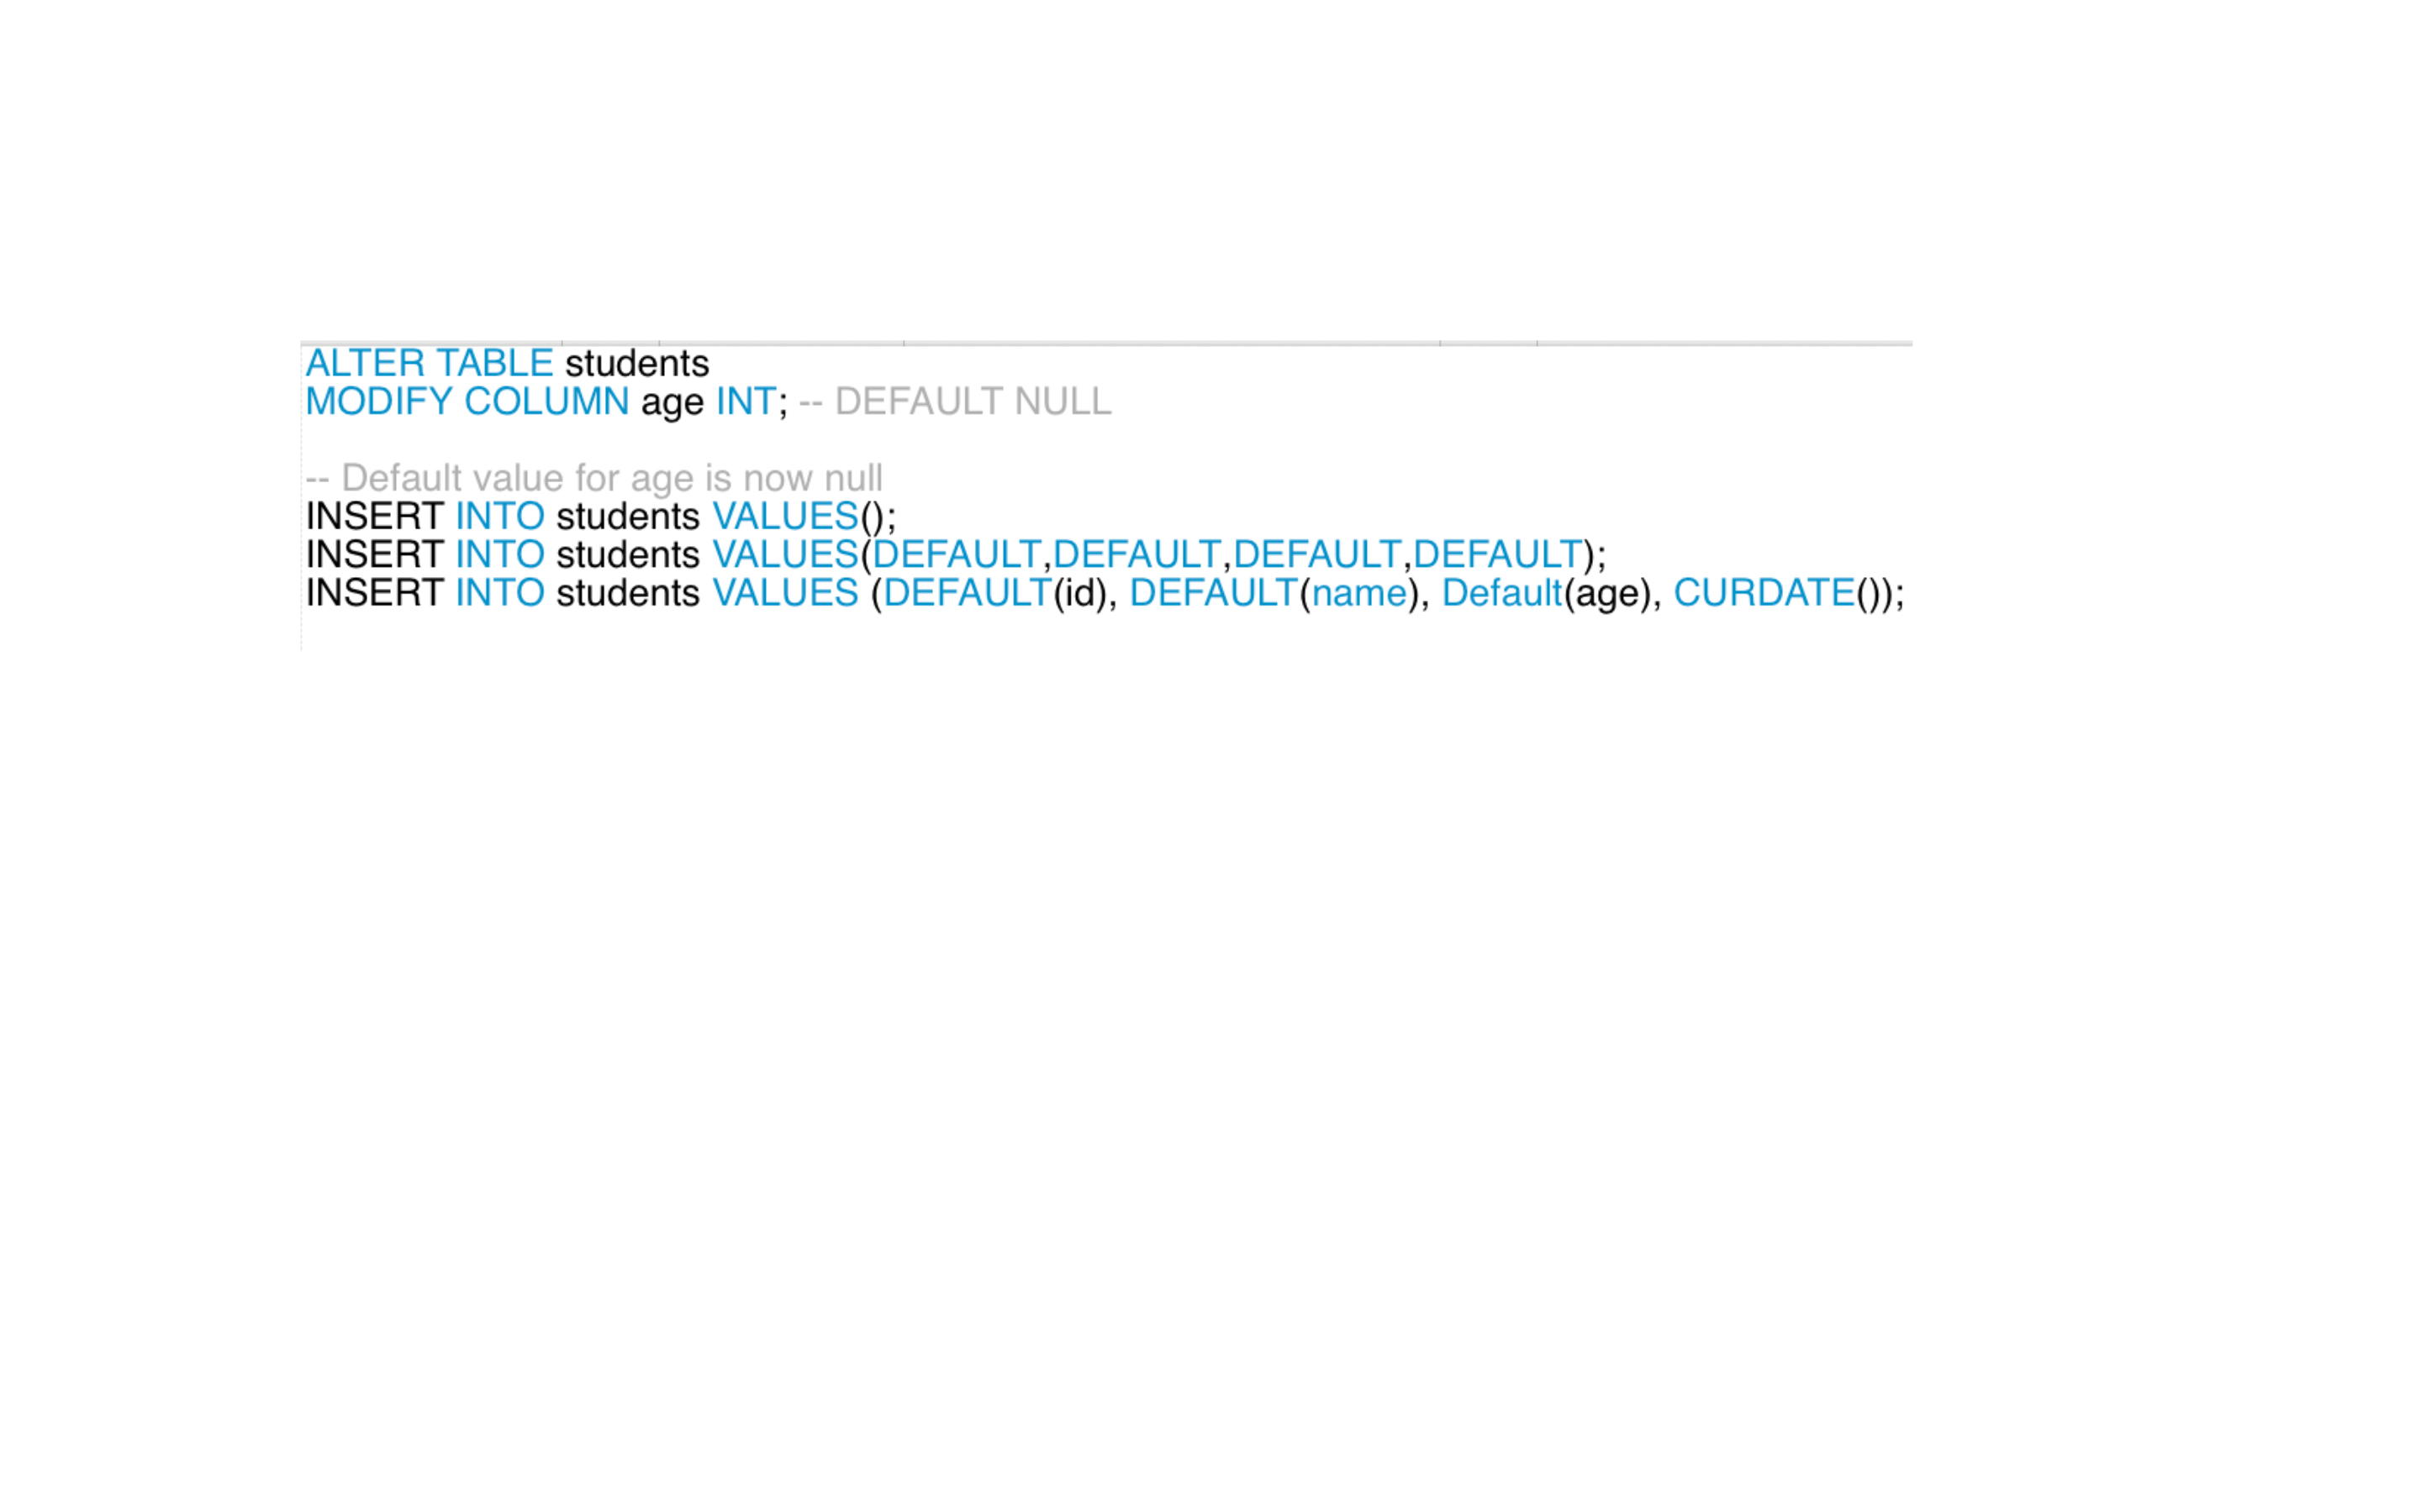
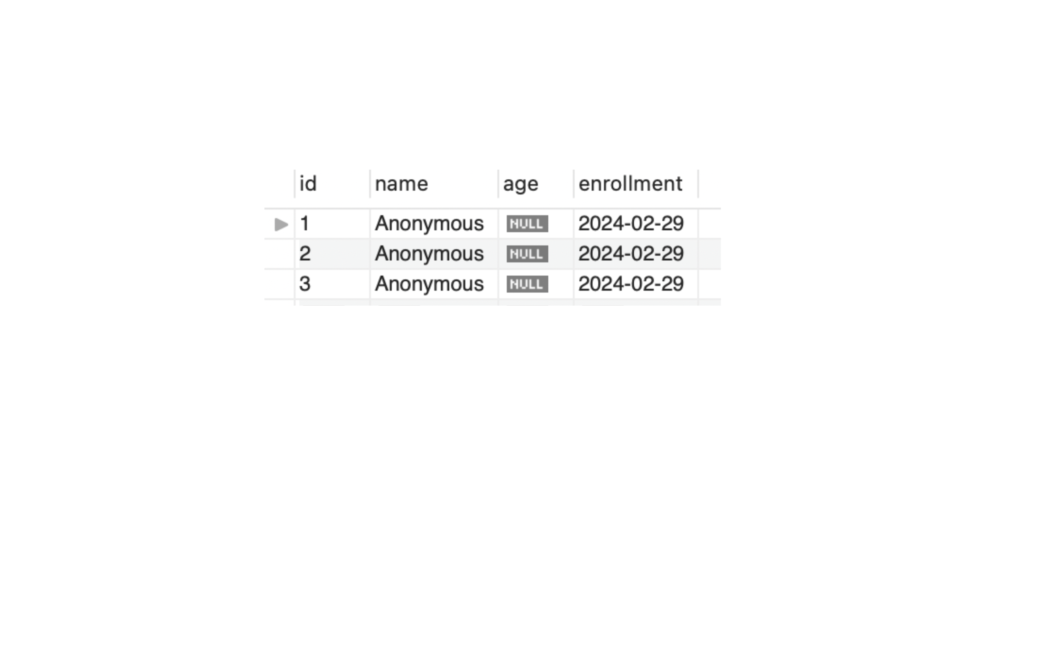
Implicit Default Handling Examples

Slide 14

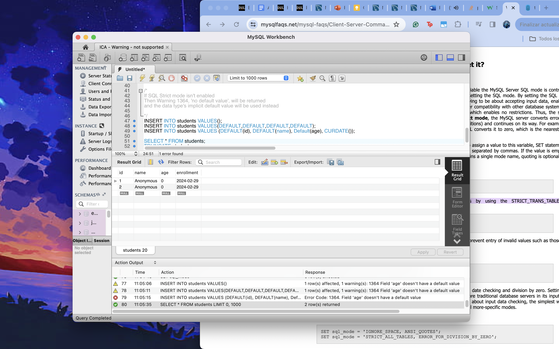
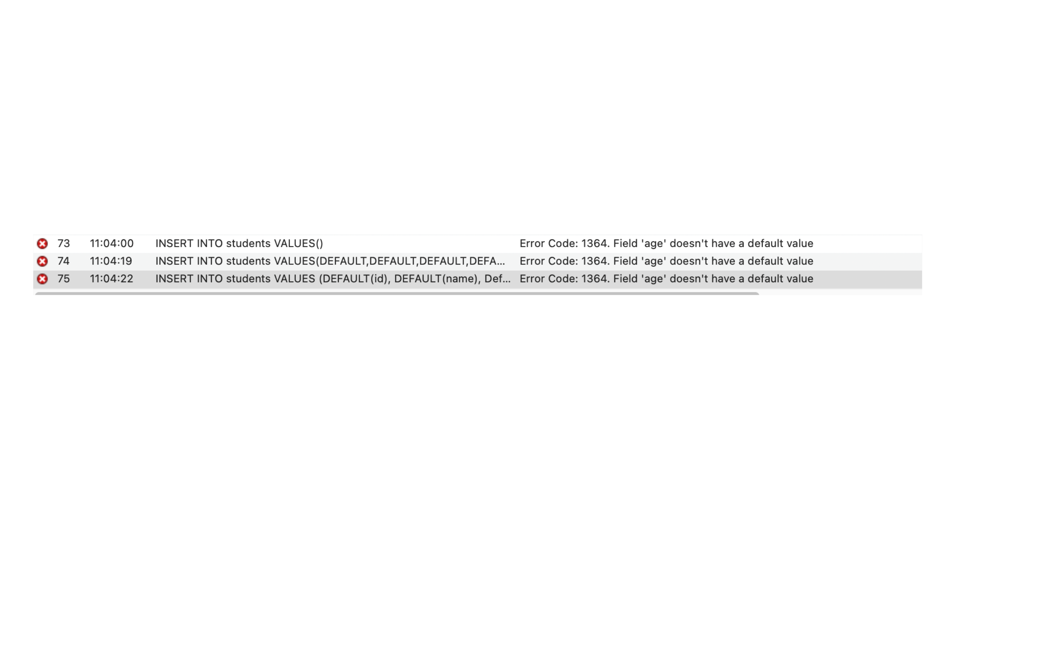
Implicit Default Handling (Not Null) Examples
If SQL Strict mode isn't enabled
Then Warning 1364, 'no default value',
will be returned, but a new record will still be made
If SQL Strict mode is enabled
Then Error 1364, 'no default value', will be returned and no new record will be made

Slide 15
Importance of Default Values
Ensures data integrity and simplifies data management
Reduces the burden on users to provide data for every field
Provides a valid value for each field which prevents NULL or undefined values that can lead to errors
Allows the user to use the default value temporarily until the explicit values are available

Slide 16
Works Cited
https://www.sqltutorial.org/sql-data-types/
https://dev.mysql.com/doc/refman/8.0/en/string-type-syntax.html
https://dev.mysql.com/doc/refman/8.0/en/char.html
https://dev.mysql.com/doc/refman/8.0/en/binary-varbinary.html
https://dev.mysql.com/doc/refman/8.0/en/blob.html
https://dev.mysql.com/doc/refman/8.0/en/enum.html
https://dev.mysql.com/doc/refman/8.0/en/set.html
https://dev.mysql.com/doc/refman/8.0/en/data-type-defaults.html

